Slide 1

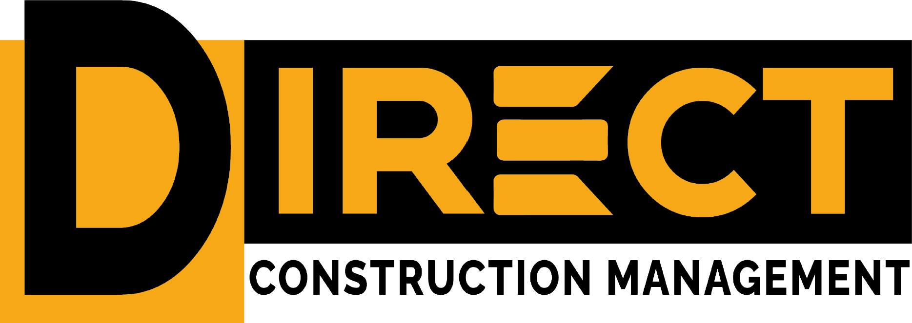
CONSTRUCTION – TRADING – CONTRACTORS

Slide 2
Construction – Trading – Contractors
E X P E C T M O R E

Slide 3

01
Content
01 Content
About Us
Group in brief
Our Vision
Our Culture
Our Directions
02 Our Services
Manufacturing
Contracting
Suppliers
Solutions
Management Services
03 Quality
04 Technology
05 Group Operations
06 Construction Projects
DIRECT

Slide 4

01
Content
A) About Us
About us
Welcome to the DIERCT Group Based in EGYPT , We at DIERCT Group have been conducting business globally since 2000 .
We are dedicated to providing quality products and expert services at competitive prices.
The Group businesses are based on the principle of risk-managed diversity. Our links with public & private sectors are the key to our past and future success. We currently represent several US and European brands in the region.
This has helped us to forge partnerships with our overseas principals who recognize the necessity to build a regional base in EGYPT Our goal is to become one of the leading groups in the region, known for its culture of best practices.
DIRECT

Slide 5




01
Content
B) Our Vision/Our Culture/Our Mission/Our Directions
Our Vision
We are providing a complete technical smart engineering solutions for electromechanical systems which meet or exceed our customer satisfaction with high quality & competitive price
To deliver all our projects with an uncompromising commitment to our customers’ needs while exceeding
their expectations through the application of cutting-edge technologies, processes and practices.
Our Culture
Our work culture is embodied in a number of principles and values that guide every ASGC employee in delivering our vision:
• Foster a professional & ethical
work environment.
• Set safety and quality as our top
priorities.
• Encourage creativity & innovation in
every aspect our work.
• Recognize the value of continuous
improvement.
• Be open, listen to our customers, &
adapt to change
Our Mission
To present all of our projects with an uncompromising commitment to the needs of our clients while exceeding their expectations by applying the latest technologies, processes and practices.
Our Directions
Our business orientations are embodied in a number of ideals and values that guide every DIERCT employee in presenting our vision:
Creating a professional and literary work structure and climate Providing safety and security methods in projects
Encouraging creativity and innovation in every aspect of our work. Learn about methods of improvement and permanent development in the work
DIRECT

Slide 6
02
Our Services
OUR SERVICES
Manufacturing
Contracting
Suppliers
Sustainable Solutions
Management Services
DIRECT

Slide 7
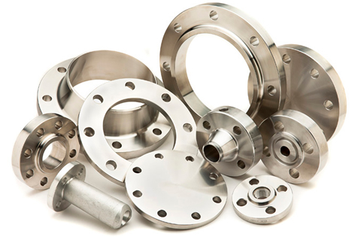
02
Our Services
A) Manufacturing
DIRECT Co. started its factory in Egypt in 2022, in line with the Egyptian government's policies to encourage the Egyptian industry and the local product in the field of ductile iron pipeline products.
DIERCT is the preeminent supplier of fittings and flanges serving a wide range of water and wastewater applications. Whether it is a water pipeline, water treatment plant or pumping station.
Flange is a method of connecting pipes, valves, pumps and other equipment to form a piping system. It also provides easy access for cleaning, checking or adjusting.
Flanges are usually welded or bolted. Flanged joints are made by joining two flanges with a gasket between them to provide a seal.
The following is an explanation of what we make in our factories

Slide 8
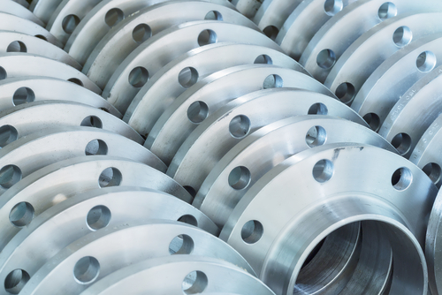
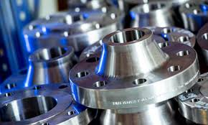
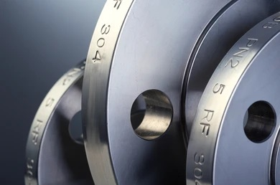
02
Our Services
A) Manufacturing
STAINLESS STEEL
CAST IRON
ALUMINUM
BRASS
BRONZE
PLASTIC
Materials FLANGES

Slide 9
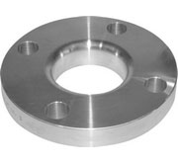
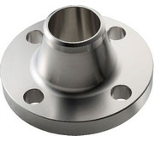
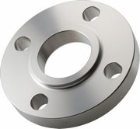
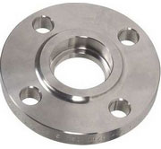
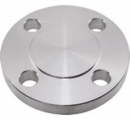
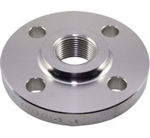
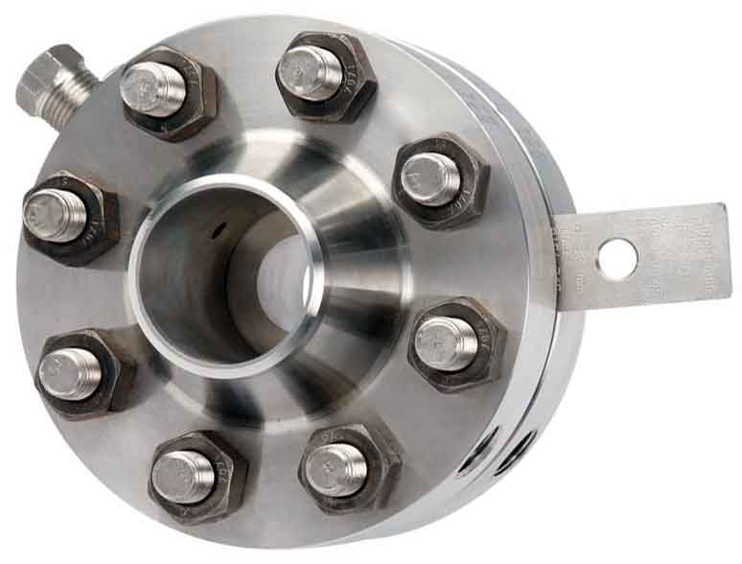
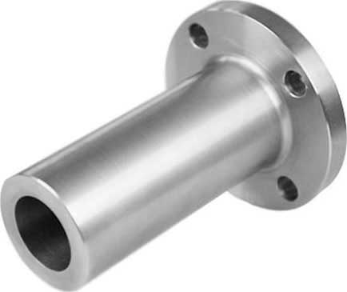
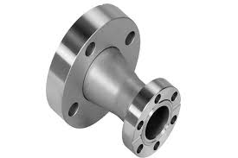
02
Our Services
A) Manufacturing
Most Popular FLANGE TYPE
Lap Joint
FLANGE
Welding Neck
FLANGE
Slip On
FLANGE
Socket Weld
FLANGE
Blind
FLANGE
Threaded
FLANGE
Orifice
Flanges
Long Welding Neck Flange
Reducing
FLANGE

Slide 10
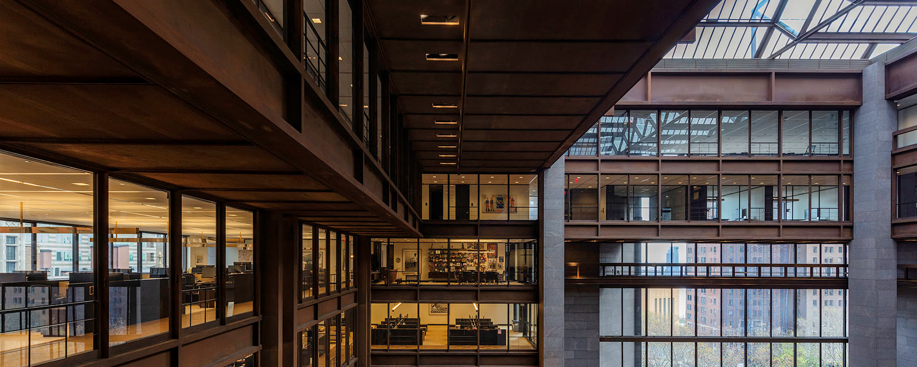
02
Our Services
B) Contracting
DIERCT CO We Aim To Provide Total “Engineering, Procurement And Construction” Solutions For
Power/Ventilation/Air-conditioning And
Infrastructure, With Wide Experience And Records
In Oil And Gas, Defense And Infrastructure Sectors
Our Team Is Fully Dedicated To Serve Client’s Specific Needs, We Invest In Complementary Design And Construction Related Services To Enrich Our Offerings And Provide You With Inclusive Services At Competitive Market Prices

Slide 11
02
Our Services
B) Contracting
We offer customers outstanding values in terms of quality, services, and cost in a timely manner by providing exceptional service in the diversified fields of design, in a safe and customer centered environment.
We at our company are committed to providing our customers with the highest standards of quality and service available. We are fully aware that the on-time delivery of our projects is a prerequisite for all of our customers.
The company has a good reputation for meeting deadlines and delivering projects successfully on schedule. We are very proud of the reputation of reliability. This was built throughout the history of the company and we aim to keep it at any cost.
What
We Do

Slide 12
02
Our Services
B) Contracting
Architecture & Engineering
Master Planning & Studies
Project Management
Construction Management & Supervision
Painting Systems Works
Carpentry Works
Oyster Business
Interior & Exterior Finishing Works
Contracting
Sector

Slide 13
Our Services
B) Contracting
02
Air Condition Systems Works
Electricity Systems Works
Plumbing Systems Works
Painting Systems Works
Swimming pool Works
Carpentry Works

Slide 14
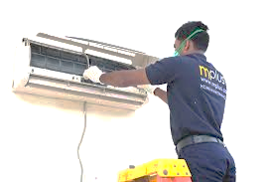
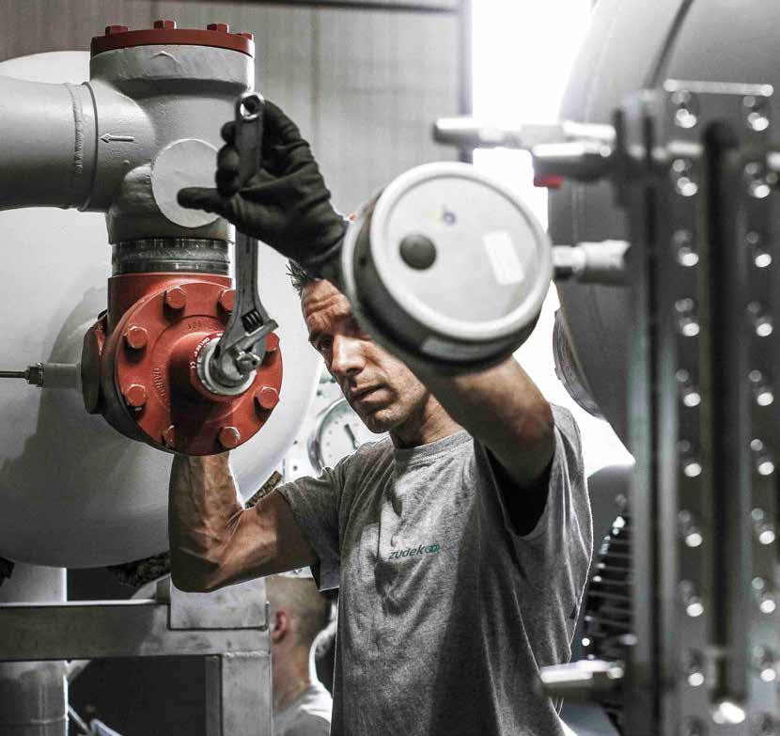
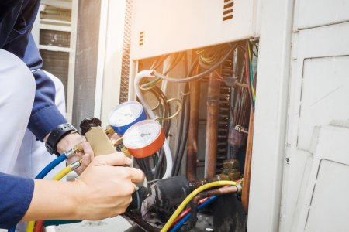
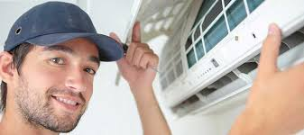
02
Our Services
B) Contracting
// Air Condition Systems Works
Providing a Varied Selection of AC Products
We offer a varied selection of brands and models, with everything from Dierct to Carrier, Trane , local brands and more up for grabs.
This is possible thanks to close connections with many of the major HVAC and AC brands operating in the States.
Our technicians are fully trained and qualified to fit a wide variety of makes and models. Head over to our Brands page to see a full list of affiliated manufacturers
We are a trusted provider of HVAC maintenance, servicing, & repairs along with air conditioning unit repairs & services. So, whatever you need to feel cool and comfortable in your favorite place, we’ve got you covered.
Direct Co specializes in high-quality air conditioning & heating installations. You can depend on our team to deliver a completely honest AC repair or replacement .
Our AC service is rated as one of the finest in the region, & all work is covered by a full warranty

Slide 15
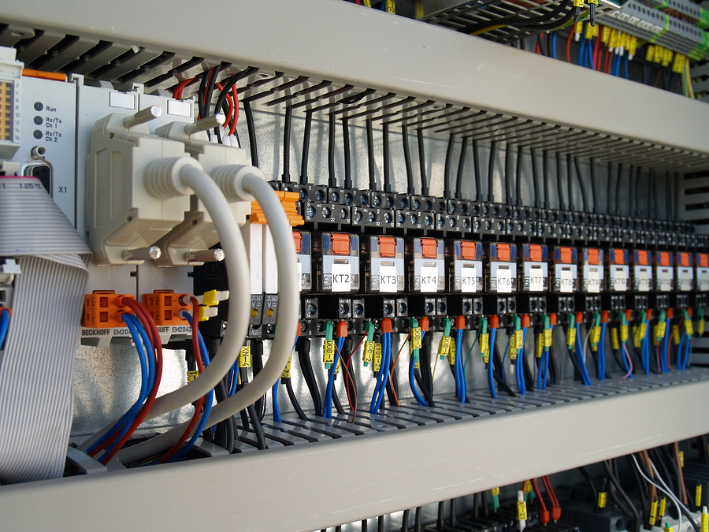

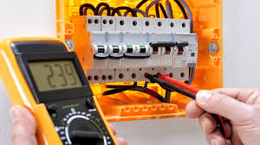
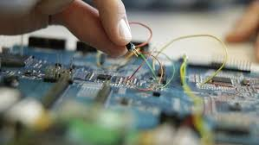
02
Our Services
B) Contracting
// Electricity Systems Works
Providing a Varied Selection of AC Products
DIERCT Co has delivered years of commercial and residential electrical services at a reasonable cost. Our residential, industrial, and commercial electricians, journeymen, and apprentices are up-to-date on all codes and can provide the best electrical services to your home or business. We work with contractors, developers, and homeowners to accommodate all electrical installation and maintenance services
We advise our customers to take great care in handling electrical wires and fittings and allow only professionals to deal with them.
We can take care of all your electrical needs safely, including circuit breakers, defective wires, complete power outages, whether it is in homes, in administrative buildings, or even in factories
Commercial Electrical Services
Residential Electrical Services
Industrial Electrical Services

Slide 16
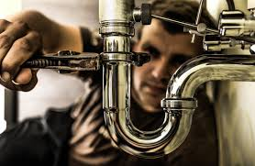
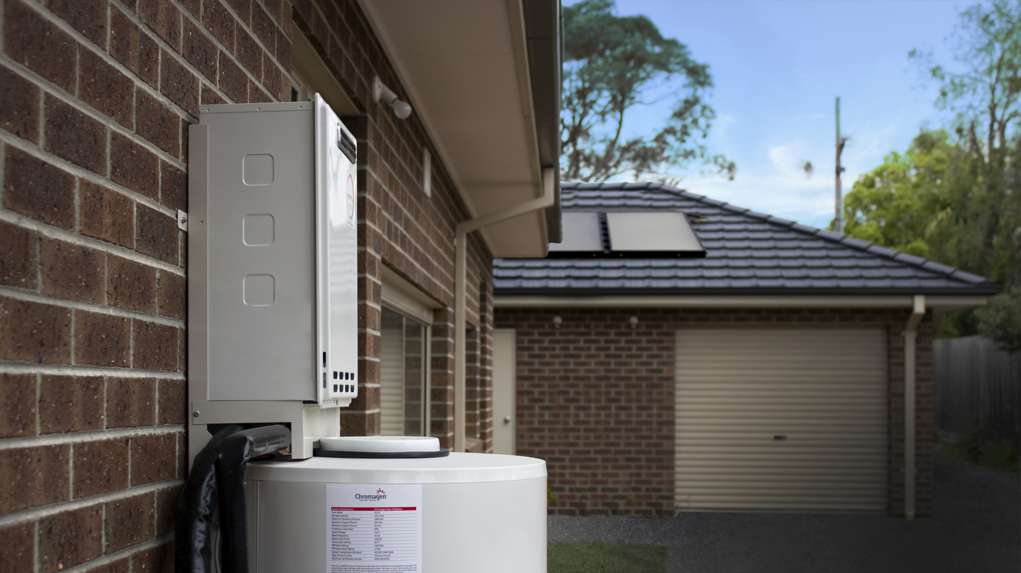
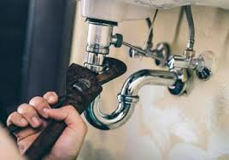
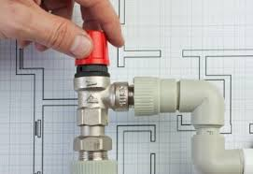
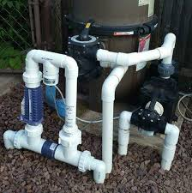
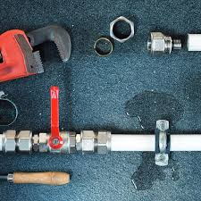
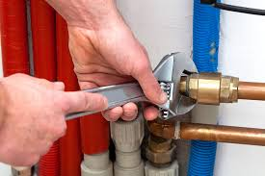
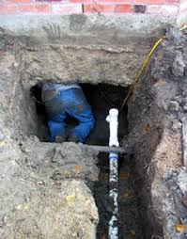
02
Our Services
B) Contracting
// Plumbing Systems Works
We advise our customers to take great care in handling electrical wires and fittings and allow only professionals to deal with them.
We can take care of all your electrical needs safely, including circuit breakers, defective wires, complete power outages, whether it is in homes, in administrative buildings, or even in factories
Experienced Professionals
Jobs Done Right The First Time
On-Time Service Providers

Slide 17

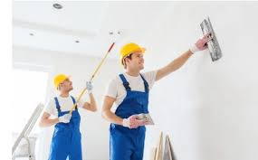
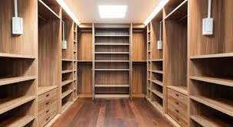


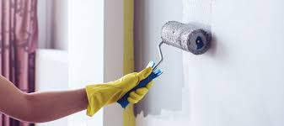
02
Our Services
B) Contracting
// Painting Systems Works
We provide a variety of painting services to clients in your home, apartment or commercial property. We guarantee that our painting exceeds the standards of the paint industry. With SGES, you can feel confident that you are hiring the best in business. Our team of painters and home decorators is made up of highly skilled and highly experienced professionals who do a delicate and clean job to exceed customer expectations.
We provide first class coating services in Dubai with great care and attention to detail. No matter the project scope or time constraints, our team will work hard to fulfill your schedule and budget. With our home painting services, you can feel comfortable knowing that the home is caring for the professionals
Factory, workshops internal & external paintings
Chimney painting with HR aluminum
Boilers and furnaces
Drinking water tanks
Gangway, Walkway painting & area marking

Slide 18
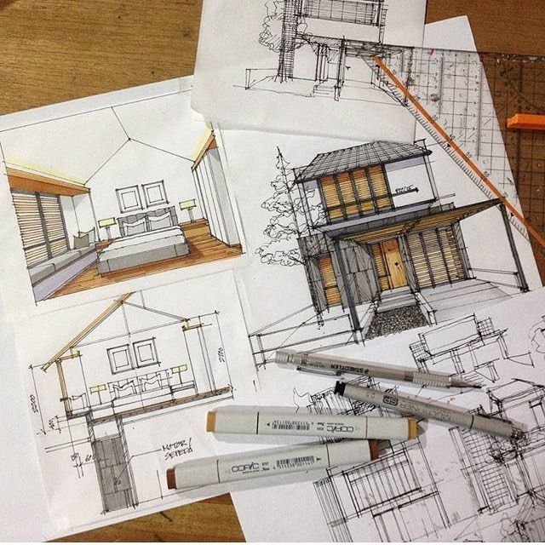
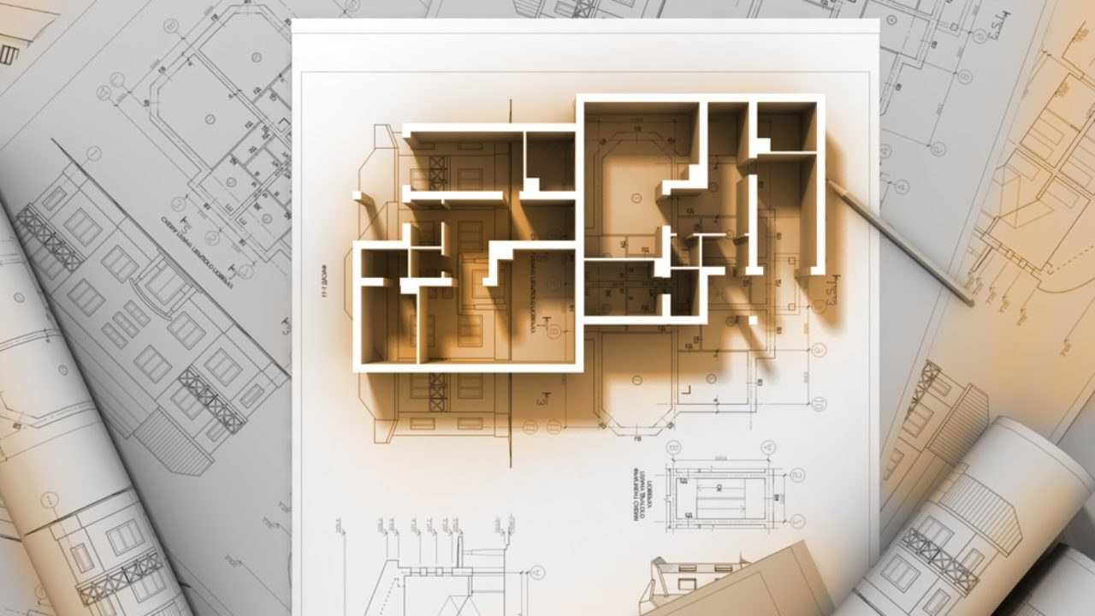
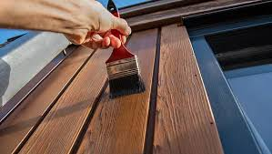
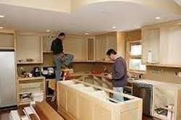
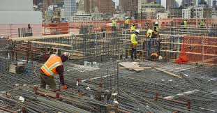
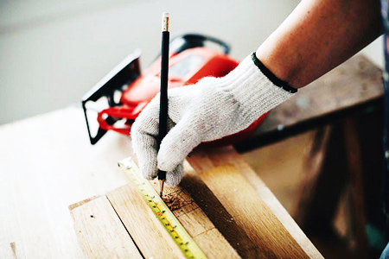
02
Our Services
B) Contracting
// Carpenter Systems Works
Different types of commercial carpenters have different roles but in general it is the job of a carpenter to:
• Interpret drawings and create either a part of it or all of it
• Layout or design part of or complete jobs
• Determine how to execute a job efficiently
• Provide advice on types of tools and materials
• Cut or shape timber
• Join or fix timber
• Accurately measure a project or component to scale
• Install carpentry work

Slide 19
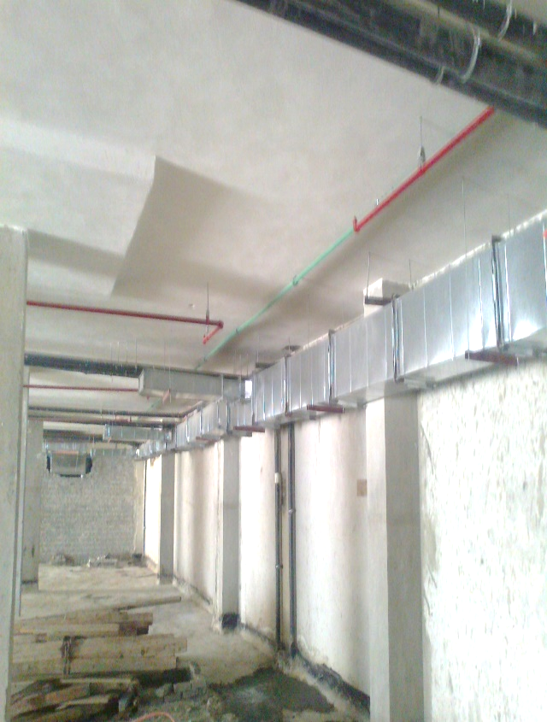
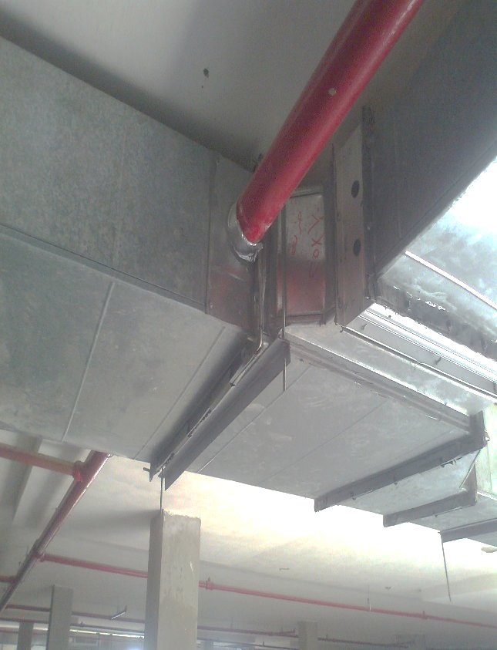
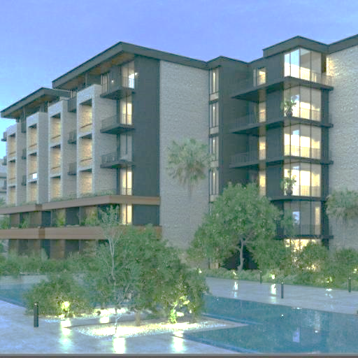
02
Our Services
B) Contracting // Reference
EL ALFY MALL
Location : Cairo - Egypt
Owner : EL ALFEY Co.
Consultant : KEM Consulting
Scope Of Work
Supplying and installing all sheet works (stainless steel) for the bank’s kitchen on the ground floor, along with supplying and installing ventilation works
TOWER BAY
Location : Port Said City - Egypt
Owner : Tower Bay
Consultant : ECG
Scope Of Work
Preparing and equipping all air conditioning works for residential apartments from the works of laying Freon pipes for split units. Preparing and equipping all sanitary works as well as extending water and drainage pipes.

Slide 20
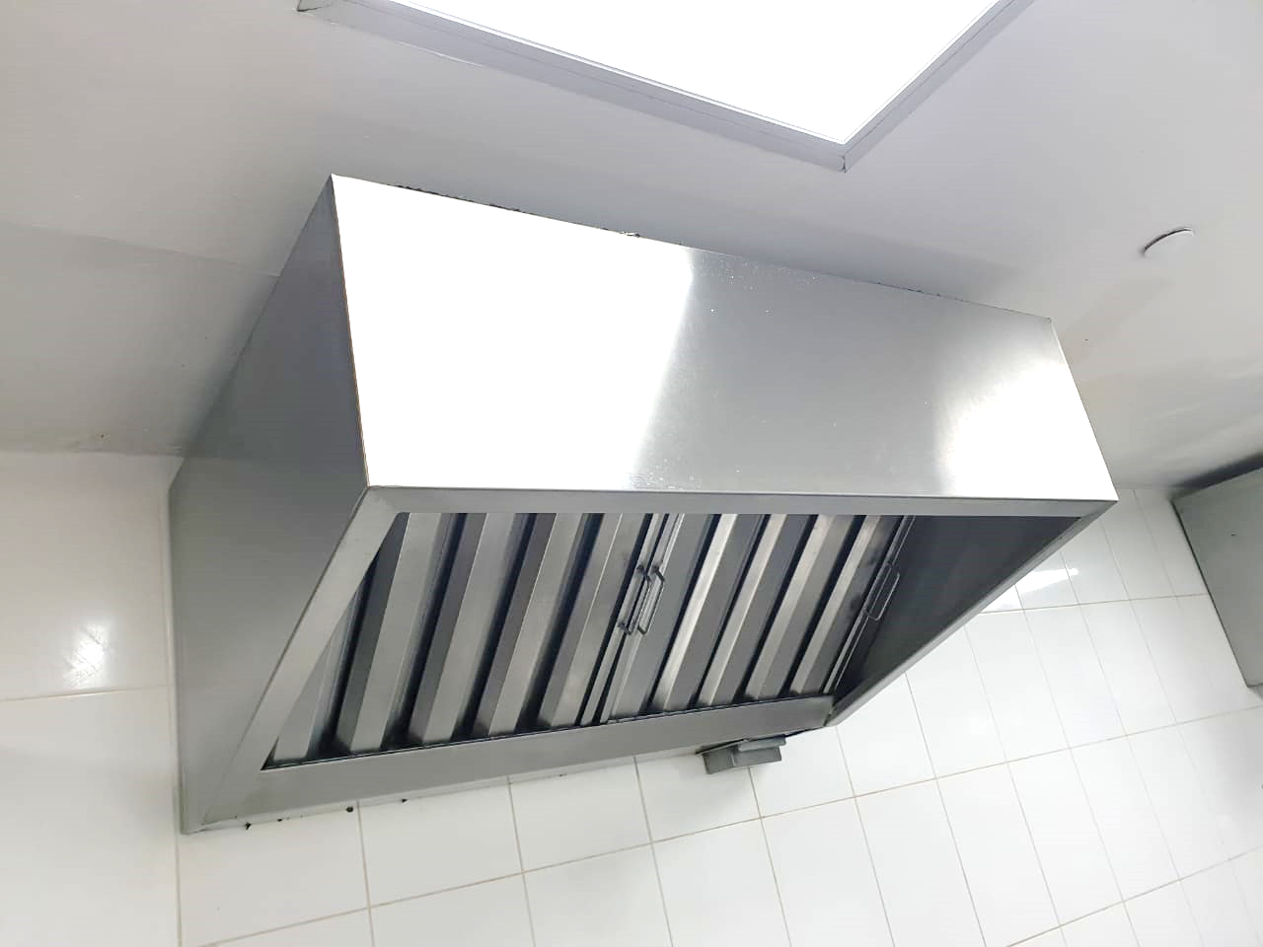
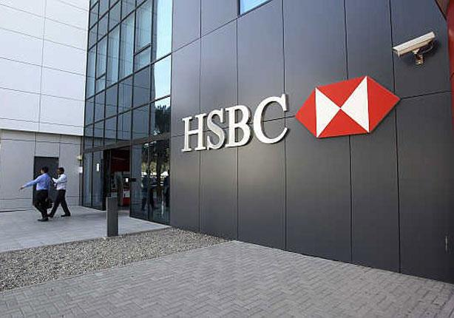
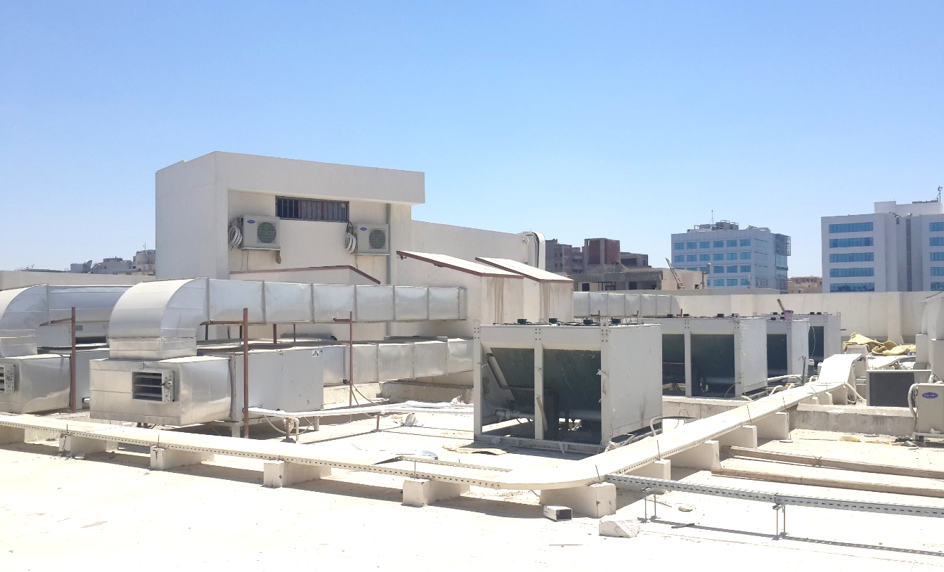
02
Our Services
B) Contracting // Reference
HSBC BANK KITCHEN
Location : Cairo - Egypt
Owner : HSBC Bank
Consultant : ECG
SCOPE OF WORK
Supplying and installing all sheet works (stainless steel) for the bank’s kitchen on the ground floor, along with supplying & installing ventilation works
SILVER MALL
Location : Cairo - Egypt
Owner : Silver
Consultant : Engineering Department
SCOPE OF WORK
Supply & installation of central air conditioning in the mall with a capacity of 180 tons of cooling (Condensing Unit + Air Handling Unit + Ventilation System )

Slide 21
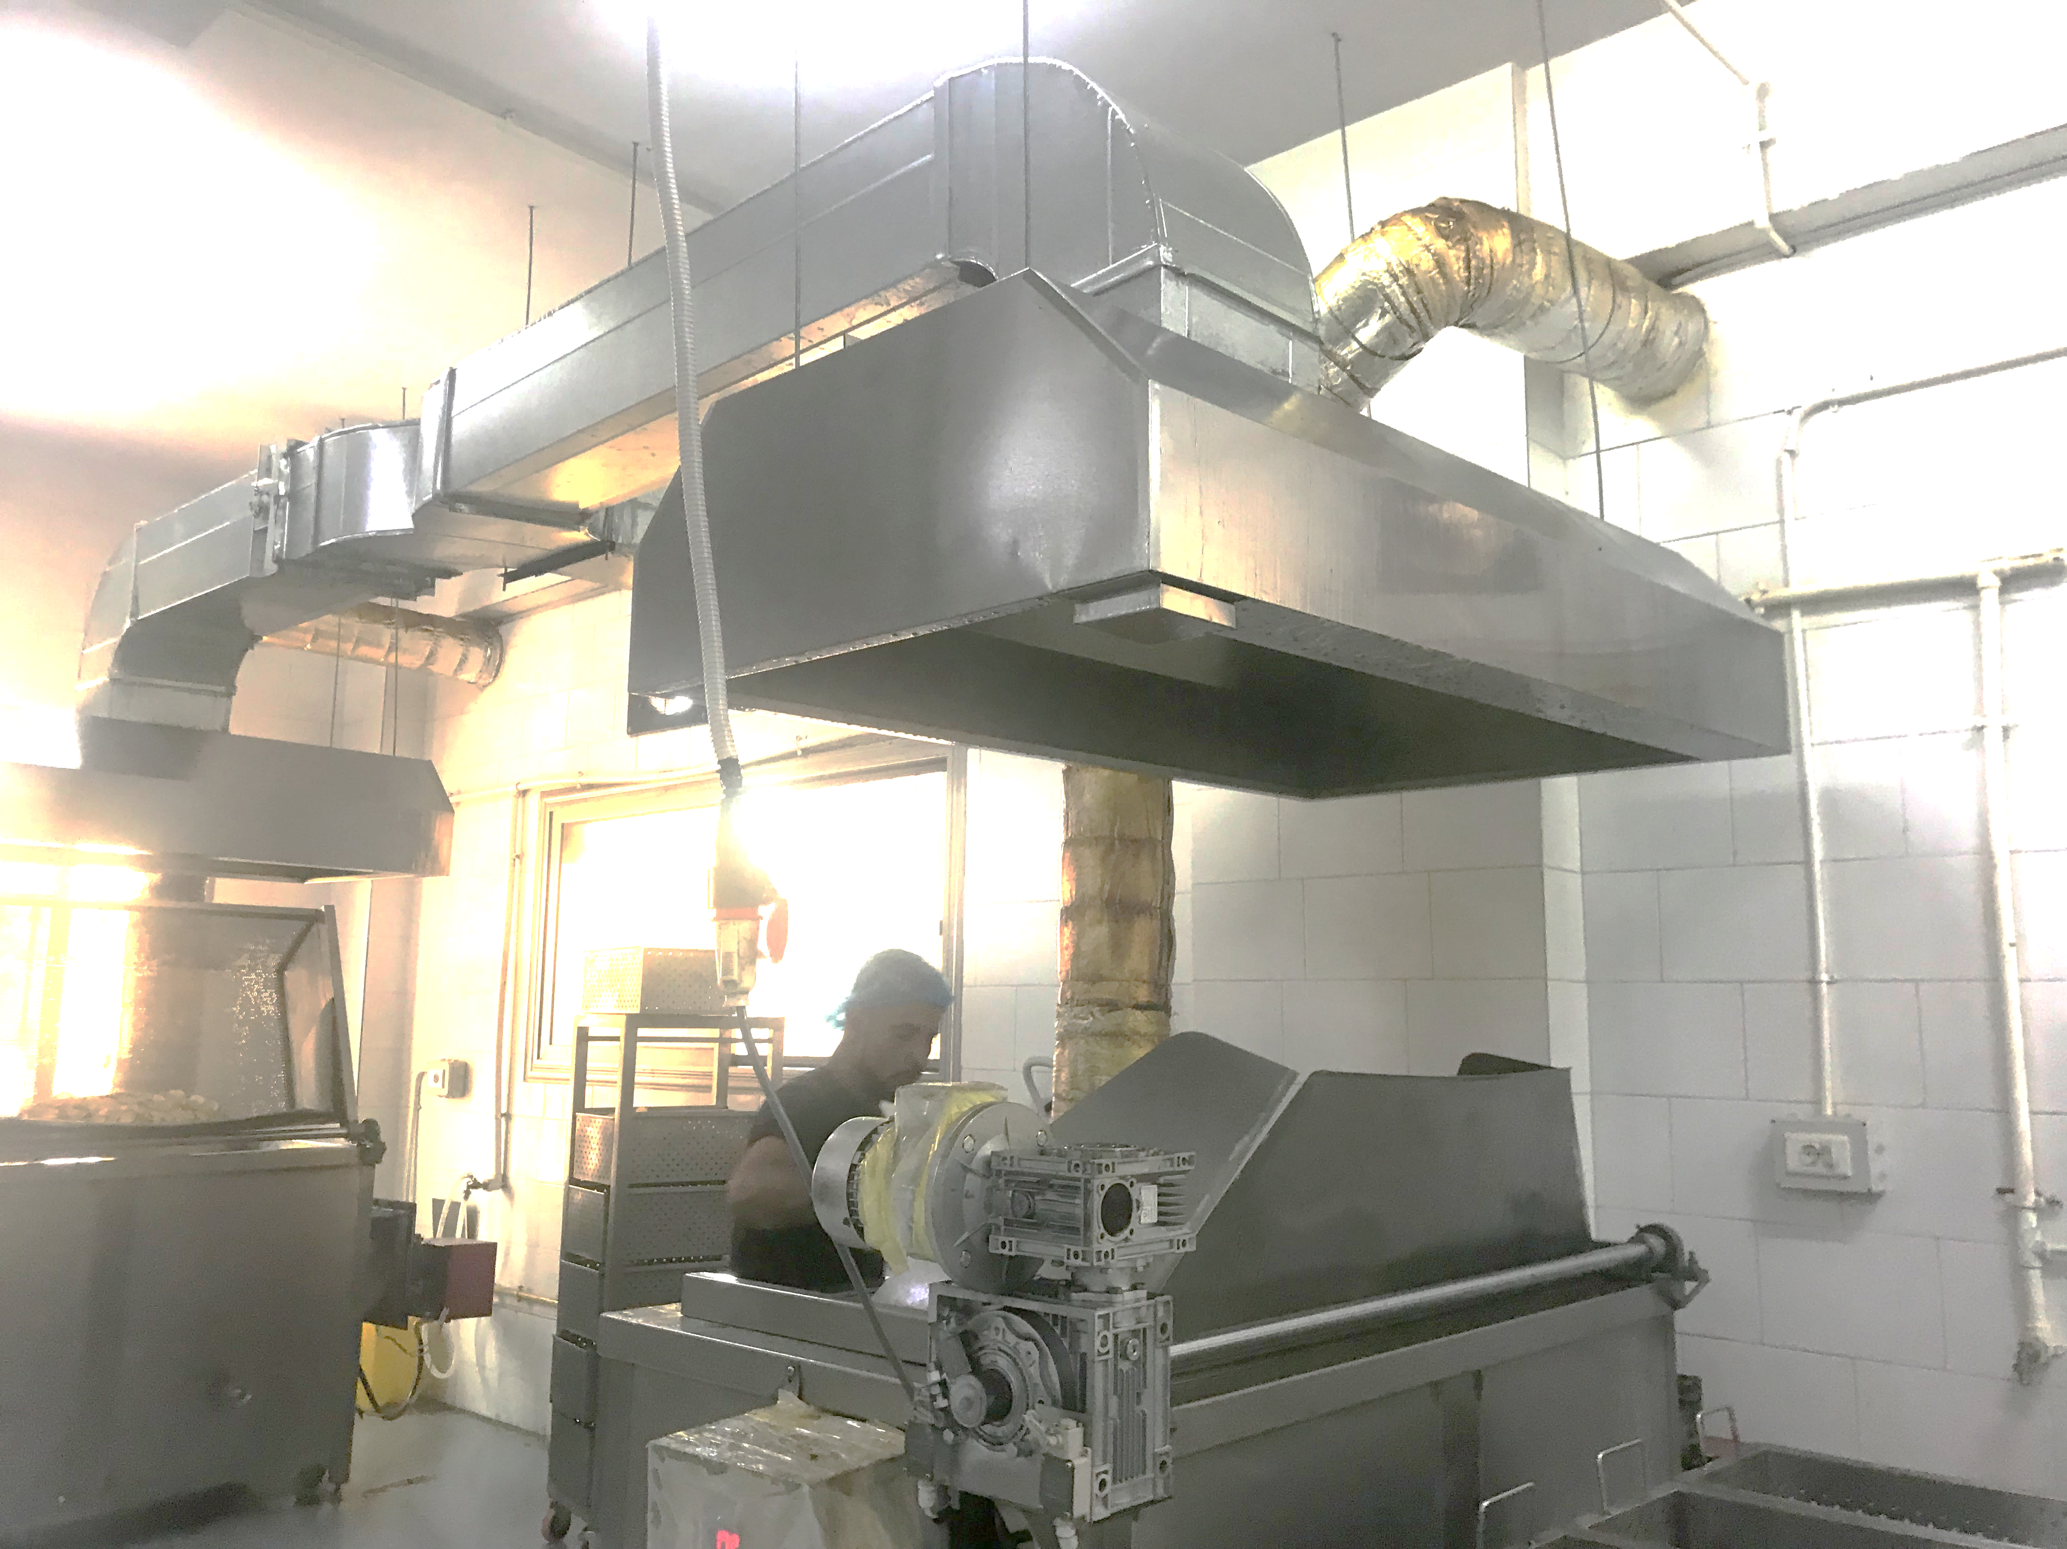
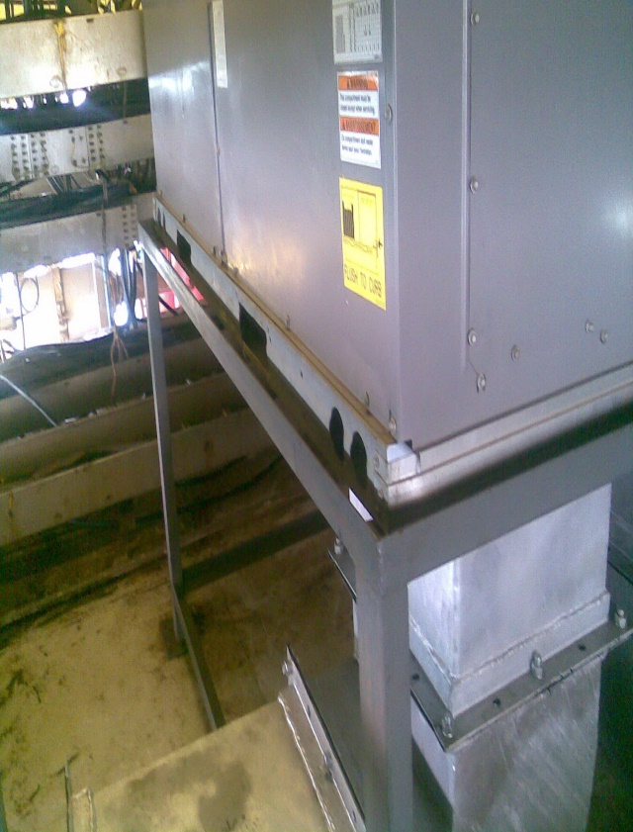
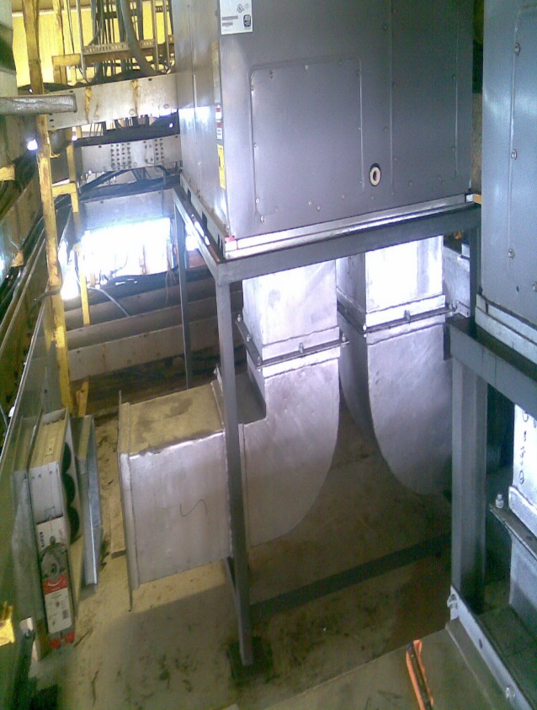
02
Our Services
Contracting
// Reference
AL SALAM FACTORY
Location : Industrial Zone, Fifth Settlement - Egypt
Owner : Al Salam Factory
Consultant : REM Consult
SCOPE OF WORK
Supplying and installing the ventilation line for the food fryer unit in the factory. Stainless steel line ventilation with 6000 CFM fans.
SIKLAM FACTORY
Location : Alex - Egypt
Owner : Al Mansour Ind
Consultant : Engineering Department
SCOPE OF WORK
Supply and installation of juice house ventilation line Galvanized steel line ventilation with 12000 CFM fans

Slide 22
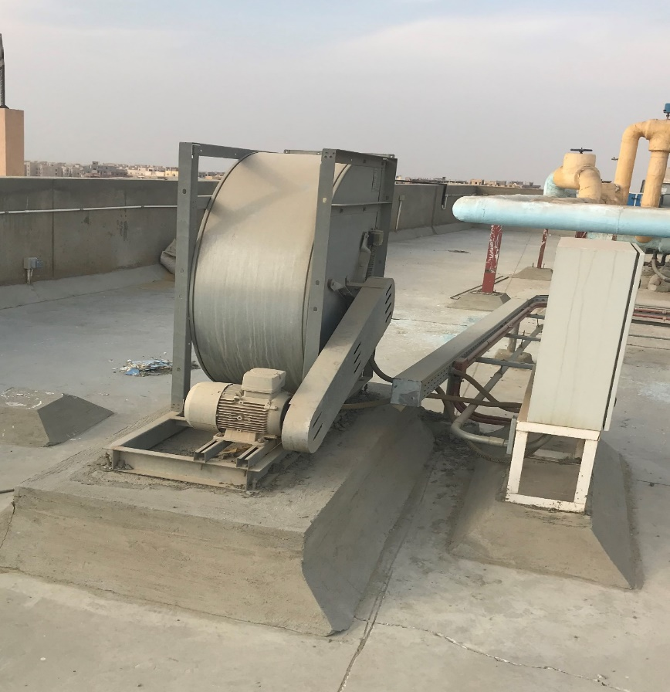
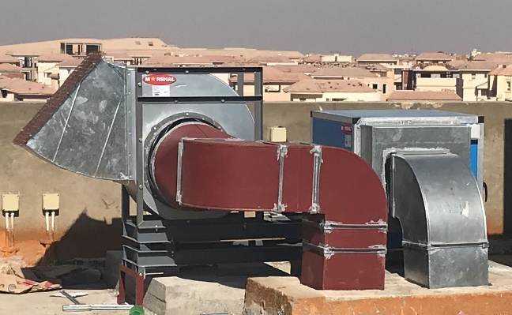




02
Our Services
Contracting
// Reference
LAVARG Factory
Location : Ain El Sokina - Egypt
Owner : Redecam Egypt Limited
CONSULTANT : ITALY Consultant
SCOPE OF WORK
Industrial Water Cooled Chiller
Supplying a chilled water cooling unit that serves the factory’s production line with a capacity of 25 tons for complete cooling with pumps, valves and expansion tank. The supply and supervision of the installation and operation were done by us
Maxim Mall
Location : El Tagamoa - Egypt
Owner : Royal Maxim
Consultant : Dora
SCOPE OF WORK
Supplying and installing the ventilation line for Some shop and corridor.

Slide 23




02
Our Services
Contracting
// Reference
General Organization for Youth Care
Location : Kuwait
Owner : Ministry of Youth
Consultant : BCE AL BENAA Consulting Engineers
SCOPE OF WORK
All installations for central air conditioning in the building, with supervision of implementation, project capacity 1,500 tons
( 2 Chiller + 8 AHU + Fan Section )
FAROS University
Location : Cairo - Egypt
Owner : Faros University
Consultant : MED Consultant
SCOPE OF WORK
Supply & installation of central air conditioning with a capacity of 125 tons of cooling (Condensing Unit + Air Handling Unit + Ventilation System )

Slide 24

02
Our Services
Contracting
// Reference
Youth Sports Club in Ahmadi-kuwate
Youth Sports Club
Construction, completion , maintenance of the group halls and individual games complex
Youth Sports Club in Ahmadi
Youth Sports Club
Location : Kuwait
Owner : General Authority for Youth and Sports
Consultant : Dar Al Khaleej Eng. Consultancy
Scope Of Work
provide all Heating, Ventilating and Air Conditioning works complete as per the Contract Documents.
The work of supervising the implementation and approvals of the advisory body with a capacity of 1,800 tons ( CHILLER / AHU / FCU /FANS /COOLING TOWER )

Slide 25

02
Our Services
Solution
Radiant
Fan Heaters
Hot Water Systems
Radiant Floor Heating
Freeze Jet Dry Ice Blasting Machine
Lighting Systems
Solution

Slide 26
02
Our Services
Solution
RADIANT COOLING WITH RADIANT CEILINGS PLAFORAD
The best thermal comfort
Guaranteed energy savings thanks water temperatures 30-35°C in heating and 15-18°C in cooling
No air stratification to the top
Very low air exchanges, no annoying air drafts
Can be combined with heat pumps and
renewable energy technologies
No maintenance
Sustainable Solutions

Slide 27

02
Our Services
Solution
AIR CONDITIONING FAN HEATERS
Series Comprises 18 Models
All Designed To Be Wall Mounted (Horizontal Air Flow)
Operate With Hot Water, Chilled Water
Painted Sheet Steel Cabinet.
Internally Insulated.
Cabinet Is Complete With Adjustable Aluminums Louvers (Spring - Operated) Placed On The Air Outlet Which Enable An Optimal Distribution Of Air Within The Air Conditioned Room.
On The Rear Of The Cabinet There Are 4 Brackets For Suspending The Fan Heater From The Ceiling Or Joining It To The Mounting Board For Installation On The Wall (Accessory).
All motors are tropicalized.
windings in class F, grade of protection IP 55.
Two Speeds
three phase
flameproof
Axial Fan
Safety grille made of electrogalvanized steel wire
Air Flow 1000 : 9000 m3/h
Heating Capacity 9 : 100 kw

Slide 28

02
Our Services
Solution
HOT WATER SYSTEMS
Energy-saving Water Heater
Renewable Hot Water Systems
Hot Water Systems
Energy savings
Wide heat pump temperature range of use (-5 to +43°C)
ACI hybrid anti-corrosion protection
PANEL HEATERS
Electric Panel Heaters
Artisan Electric Panel Heater

Slide 29




02
Our Services
Solution
Radiant Floor Heating
Quiet way to heat with no visible ducts, radiators or holes
Increases comfort with constant, low heat
Better air quality, eliminates blowing dust from ductwork
Will not dry out your skin or sinuses, does not rob air of moisture
Can increase energy efficiency
Hydronic Radiant Floor Heating
The water system works best when used across the entire home (similar to a radiator system) or large floor areas, and run constantly during cold weather to maintain an even temperature. It needs to be installed between existing subfloor with new flooring above it. This increases the thickness of your flooring. Systems can be installed on the underside of floors, such as the basement ceiling, but this tends to reduce the conductive effectiveness

Slide 30






02
Our Services
Solution
Freeze Jet Dry Ice Blasting Machine
Automotive Industry/Manufacturing
Cleaning Contractors
General Maintenance & Facilities
Petrochemical
Power Generation
Food Processing
Pulp & Paper

Slide 31




02
Our Services
Solution
LIGHTING SYSTEMS
INDOOR LIGHTING
Down Lights
Surface Mounted
Wall Lights
Spot Lights
Mini Panel Lights
Linear Lights
LED Lamps
OUTDOOR LIGHTING
Outdoor Wall Sconces
Bollard Lights
Drive Way Lights
Recessed Up Lights
Facade & Flood Lights
Path & Spike Lights
Underwater Lights

Slide 32
03
OUR Quality
We have established ideals for ourselves that we commit to in order to ensure that every project, service and touchpoint meets these standards.
We have developed a series of procedures and processes that reflect our quality and on-time delivery ethos.
These are available to all workforce. Regular updates and training sessions are held to ensure meeting, exceeding and continuously improving these standards.
We ensure that controls of resources, workmanship, documentation, inspection and testing, handover and all other on- and off-site activities are fully planned, established and implemented.
Quality of Construction
Quality of Services
Quality of Operations
Quality of Internal Processes

Slide 33
04
Company Division
Building Material

Slide 34







04
Company Division
Building Material
we are produces top class products that suits the international standards and leaves an impression as we know and believe from heart that a company is recalled by its clients for the standard of its produces. Our policy is to retain a client while we expand our market share.
At present, we produce for the sectors like air transport, municipalities, railways, highway infrastructure, telecommunications, automotive, electricity, HVAC and water supply.

